Slide 1
Moving Sources
Influence of spatial separation and source movement on listening effort
Annika Beyer
Johannes Rolfes

Slide 2
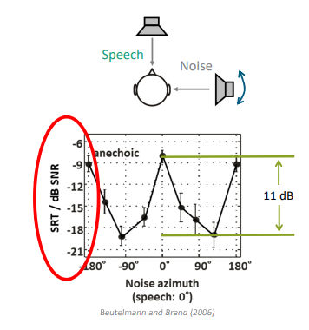
What‘s the Idea ?
Benefit from spatial separation of the Noise from the target speaker

Slide 3
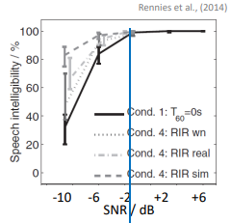
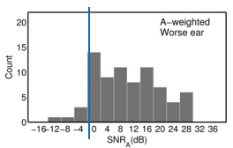
What‘s the Idea ?
Speech intelligibility (SI) often ends in negative SNRs although the Listening situation is not effortless
Listening effort (LE) as a addition to the common speech tests

Slide 4
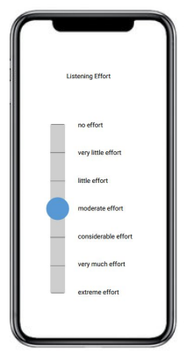
What‘s the Idea ?
Investigate LE for listening in an virtual room while sources move (e.g. simulating head movement)

Slide 5

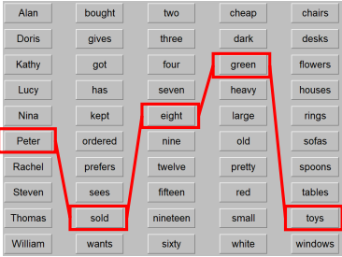
method
Usage of TASCAR
Target speech are OLSA sentences

Slide 6
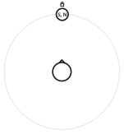
Pre-Measurements : S₀N₀
signal: OLSA
stationary noise: Olnoise
SNR = -7 dBSNR
sources 1 m from middle of the head
SPL at the head= 65 dB SPL
No reverbaration
test of the model:
measure Speech intelligibility
measure Listening effort

Slide 7
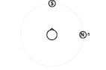
Pre-Measurement : S₀N₉₀
signal: OLSA
stationary noise: Olnoise
SNR = -7 dBSNR
sources 1 m from middle of the head
SPL at the head= 65 dB SPL
No reverbaration
test of the model:
measure Speech intelligibility
measure Listening effort

Slide 8
Expected Outcome
SI will get better at spatial separation of the sources
practical proof of the model
Relation between SI and LE

Slide 9
Main-Measurement : S₀N_{rotating}
Measurement with stationary noise in circular movement and speaker in front
Signal: OLSA
stationary noise: Olnoise
sources 1 m from middle of the head
SPL at the head= 65 dB SPL
No reverberation
measure LE

Slide 10
Main-Measurement : S_{0rotating}N_{180rotating}
Measurement with stationary noise and speaker 180 degrees from each other moving in circular movement (like turning the head)
signal: OLSA
stationary noise: Olnoise
sources 1 m from middle of the head
SPL at the head= 65 dB SPL
No reverberation
measure LE

Slide 11
Main-Measurement : S_{0rotating}N_{-90/+90rotating}
Measurement with 2x stationary noise 180 degrees from each other moving in circular movement (like turning the head) and speaker from front
signal: OLSA
2 x stationary noise: Olnoise
sources 1 m from middle of the head
SPL at the head= 65 dB SPL
No reverberation
measure LE

Slide 12
Main-Measurement : S₀N_{rotating} with fluctuating noise
Measurement with fluctuating noise in circular movement and speaker in front
Signal: OLSA
stationary noise: Olnoise
sources 1 m from middle of the head
SPL at the head= 65 dB SPL
No reverbaration
measure LE

